Slide 1

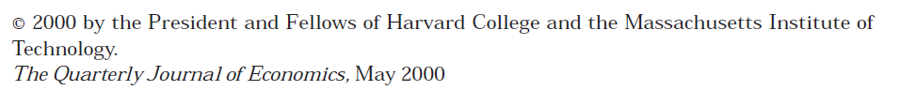
Presented by Paul George

Slide 2
Principal hypothesis/point of paper
How health responds to transitory changes in economic conditions
Hypothesis: Contrary to previous studies and general consensus, health improves when the economy temporarily deteriorates.
Specifically, state unemployment rates are negatively related to total mortality
Suicide is an important exception

Slide 3
Why is this topic important?
Strong intuition towards health worsening with economic downturns
Policy impacts – perhaps more aggressive public health campaigns during booms, more mental health support during downturns
Workplaces – support for employees
Help elucidate drivers of mortality
Notes:
He doesn’t really address this in the paper
Especially preventable mortality

Slide 4
What is the contribution of the article to the literature?
Previous work (e.g., Harvey Brenner) uncovered health declines with downturns in the economy
Though others failed to replicate this work, effects were inconsistent
Previous work hypothesized that downturns cause worse health by increasing stress and risk-taking, whereas Ruhm invokes the Grossman model

Slide 5
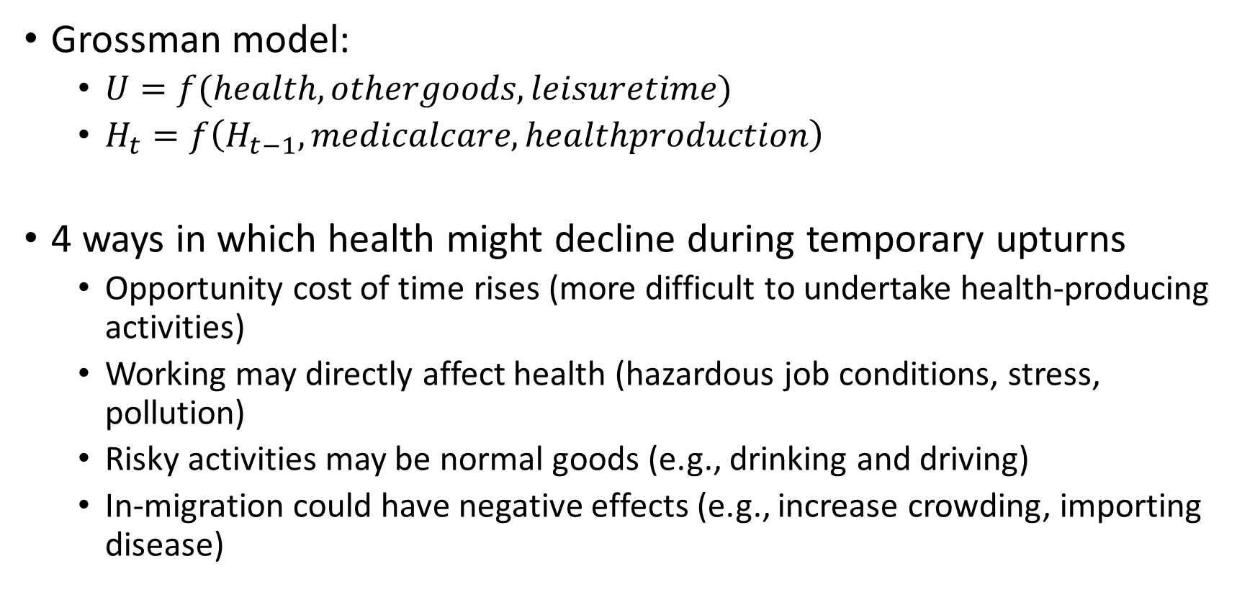
Theory
Grossman model:
$U=f(health, othergoods, leisuretime)$
$H_{t}=f\left(H_{t−1}, medicalcare, healthproduction\right)$
4 ways in which health might decline during temporary upturns
Opportunity cost of time rises (more difficult to undertake health-producing activities)
Working may directly affect health (hazardous job conditions, stress, pollution)
Risky activities may be normal goods (e.g., drinking and driving)
In-migration could have negative effects (e.g., increase crowding, importing disease)

Slide 6
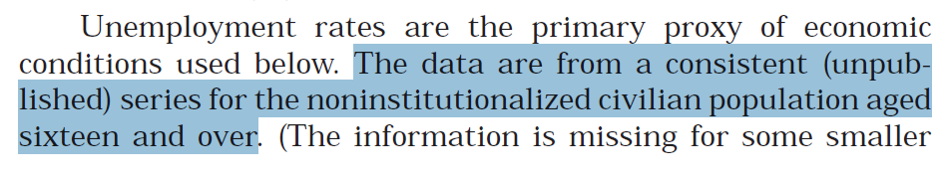
Data used
Data on fatalities are from Vital Statistics of the United States from the U.S. Census
50 states + D.C., 1972-1991
Includes cause-specific mortality (using ICD-9 categories)
Data on lifestyle behaviors are from Behavioral Risk Factor Surveillance System (BRFSS)
50 states + D.C., 1987-1995
Outcomes included tobacco use, drinking, weight, physical activity, diet, preventative medical care

Slide 7
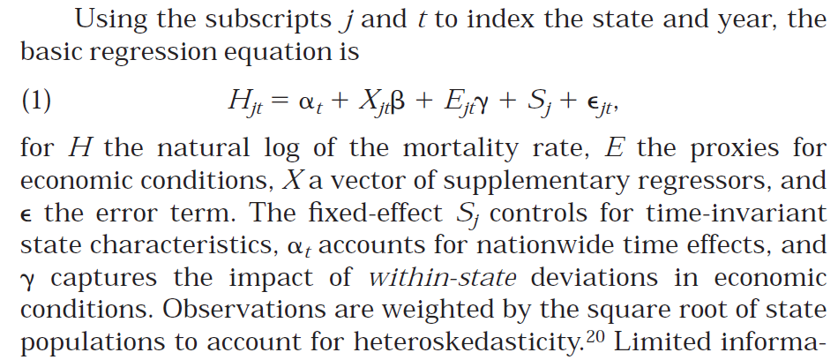
Methods
Regressions hold constant: state-level education, Black & Hispanic percentage, age (<5 years, >65 years)

Slide 8
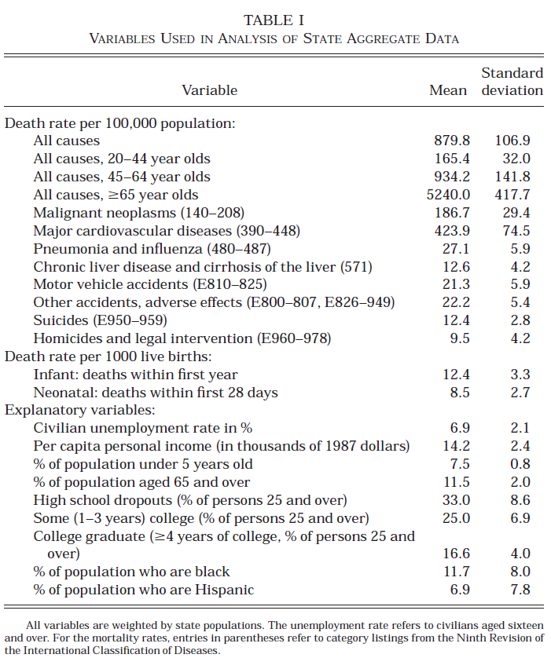
Results (Table 1)

Slide 9
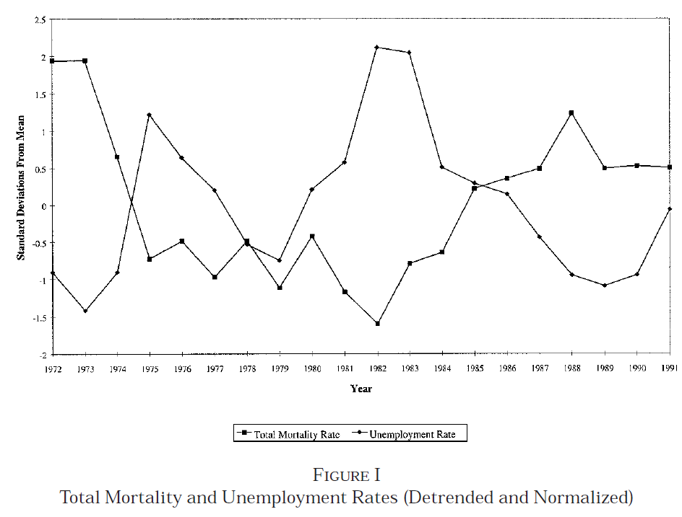
Results (Figure 1)
Vietnam war ends
AIDS epidemic
Gulf war
Drugs/war on drugs
Reaganomics
Notes:
Figure illustrates a strong inverse relationship between economic conditions and fatality rates

Slide 10
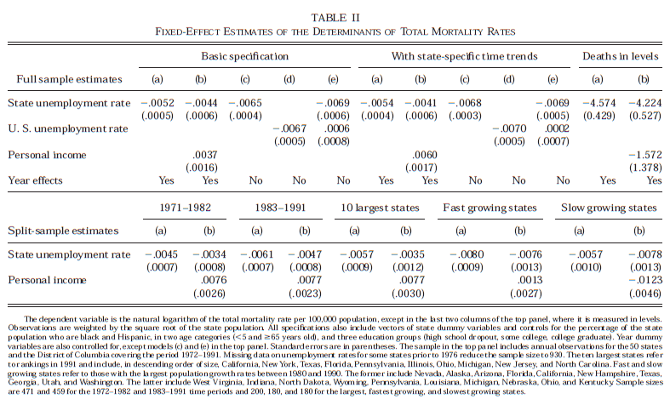
Results - Main model, dependent variable = ln(death rate)
Notes:
Dependent variable is the natural logarithm of the death rate
Independent variable is state unemployment rate

Slide 11
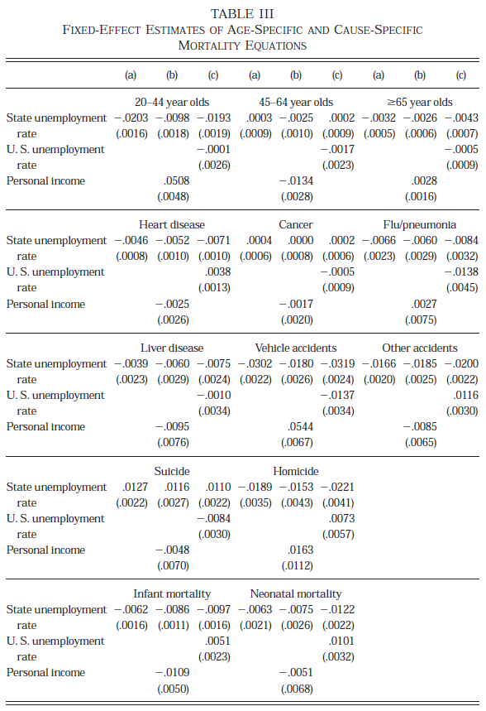
Results (cont’d)
Notes:
Dependent variable is the natural logarithm of the death rate
Independent variable is state unemployment rate

Slide 12
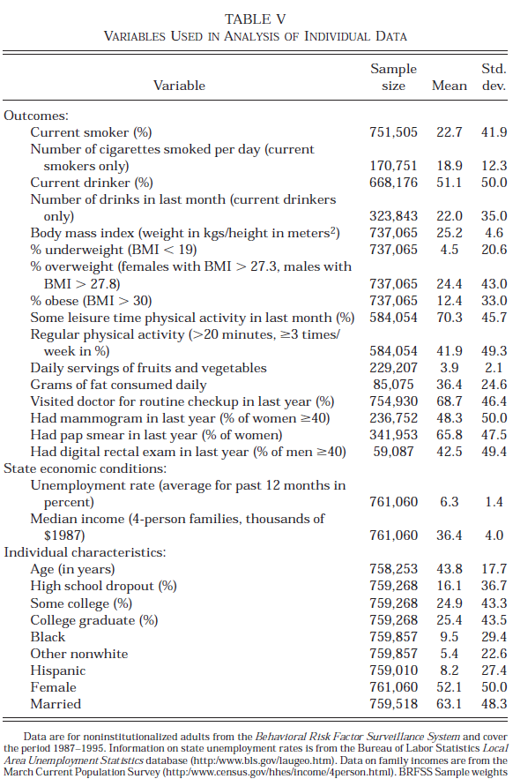
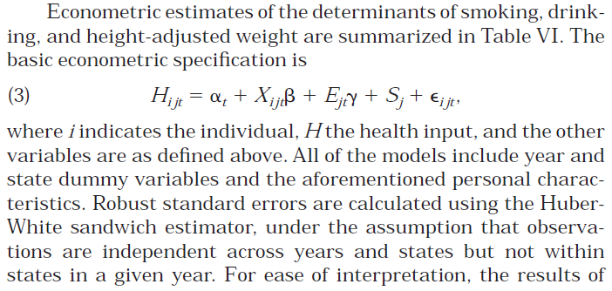
Results (evidence from microdata)

Slide 13
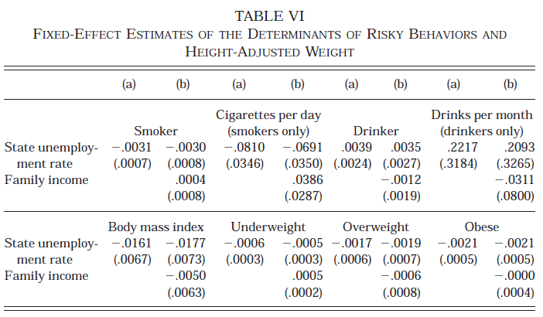
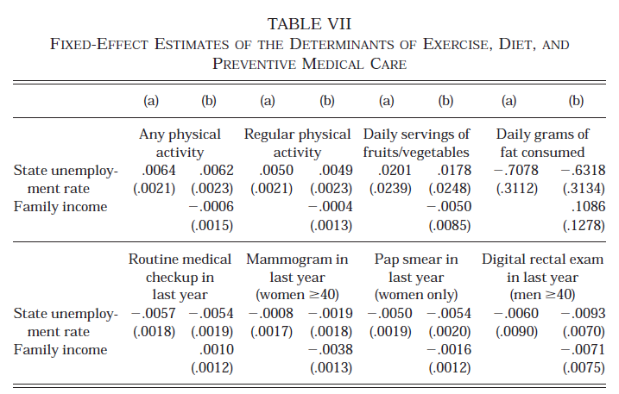
Results
Consistent with hypothesis: smoking, body weight
Inconsistent: drinking
Consistent with hypothesis: physical activity, grams of fat consumed
Inconsistent: medical checkup, pap smear

Slide 14
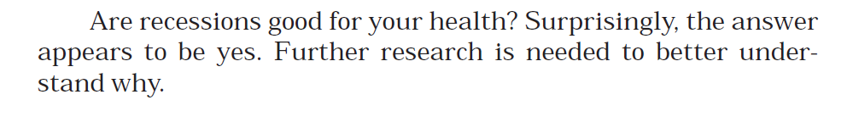
Main conclusion
Specifically, there is a significant inverse relationship between unemployment and mortality
A one percentage point rise in the state unemployment rate, relative to its historical average, is associated with a ~0.5-0.6 percent decrease in total mortality (~11,000 fatalities annually)

Slide 15
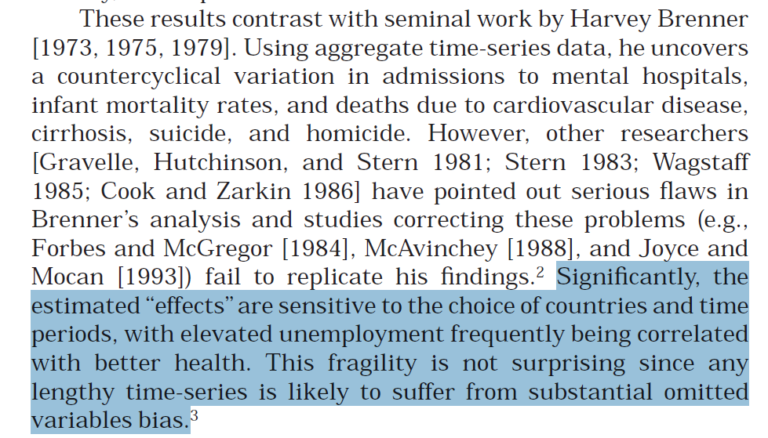
Commentary
Reverse causality (i.e., can worse health cause worse economic conditions?)
Omitted variables
Unemployed persons may move to states with better economic conditions
Trouble with survey data
I wish he would have used employment (instead of unemployment)
They do a lot of sub-analyses (good and bad)

Slide 16
New research ideas
Causal inference designs to determine employment and mortality
Extend study to other high-income countries

